Slide 1

I Maze Solving Robot I
Ladybug Bot

Slide 2

I Chassis Construction I
I Design & Creation I

Slide 3
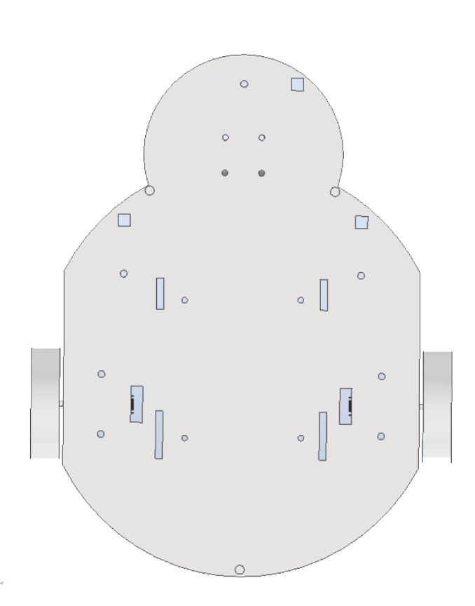
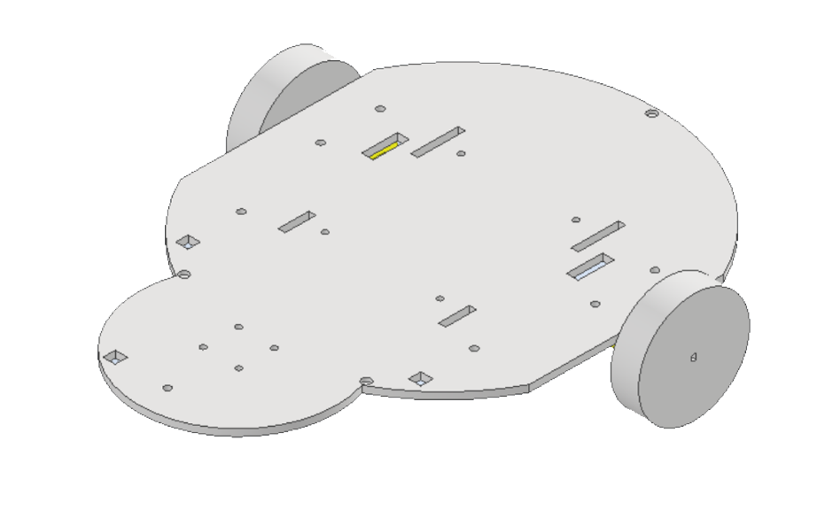
Design - Base
Designed with the ladybug concept in mind
Large “body” section - ARB board, battery pack
Smaller “head” section - ball caster is mounted in direct centre
Ultrasonic sensors
One at direct front, and one on each side
Battery pack slots
Four rectangular slots in the centre
Battery pack stand slots in & out (keyhole)

Slide 4
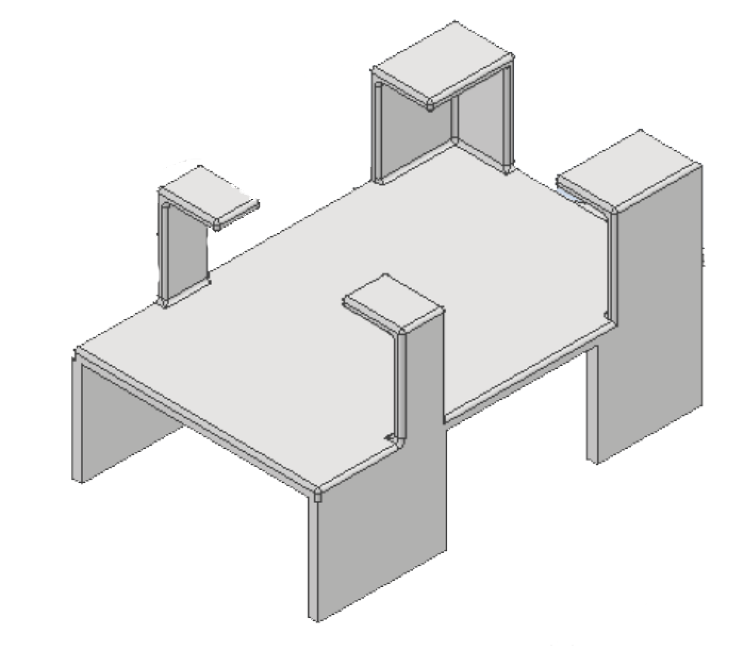
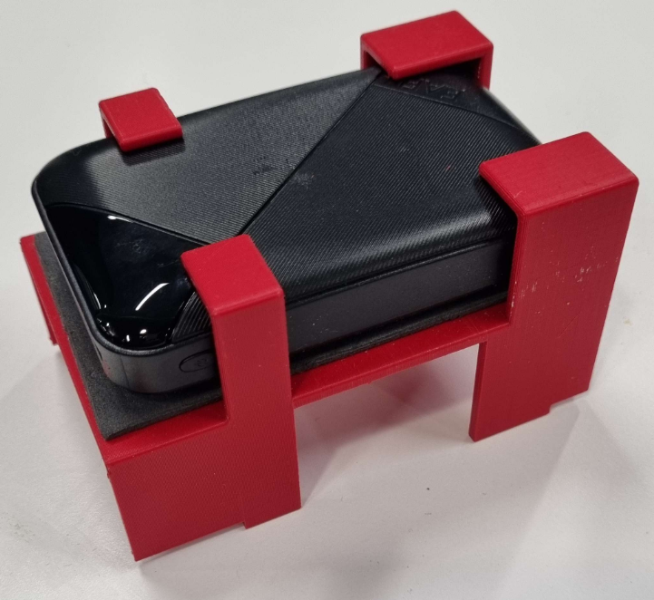
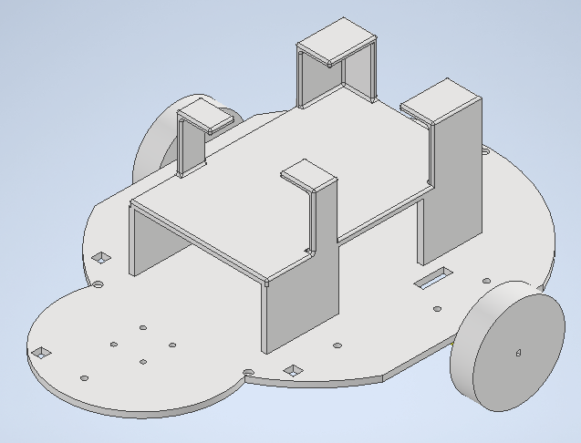
Design - Battery Pack
A stand that slots through the keyholes and rests above the ARB board.
Small layer of foam to protect the battery pack and allow it to be removed in and out.
Rounded slots on top to increase safety during use
Printed in red to stick with the ladybug theme.

Slide 5
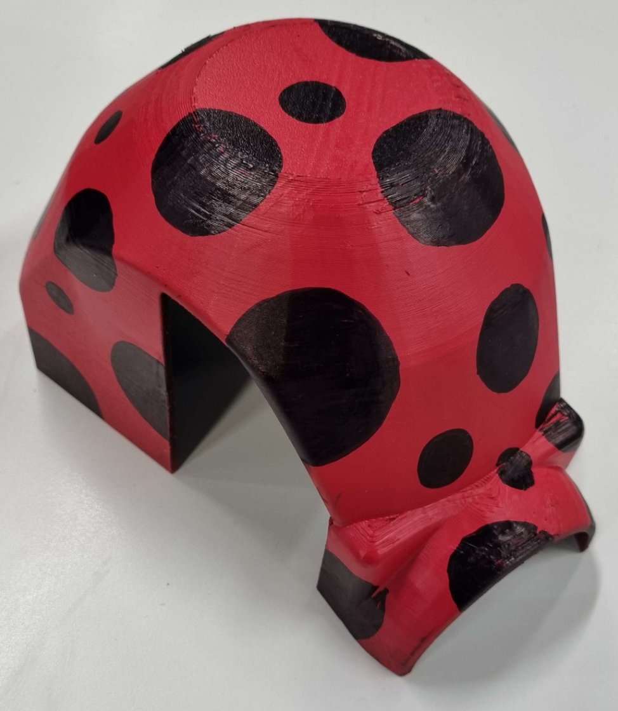
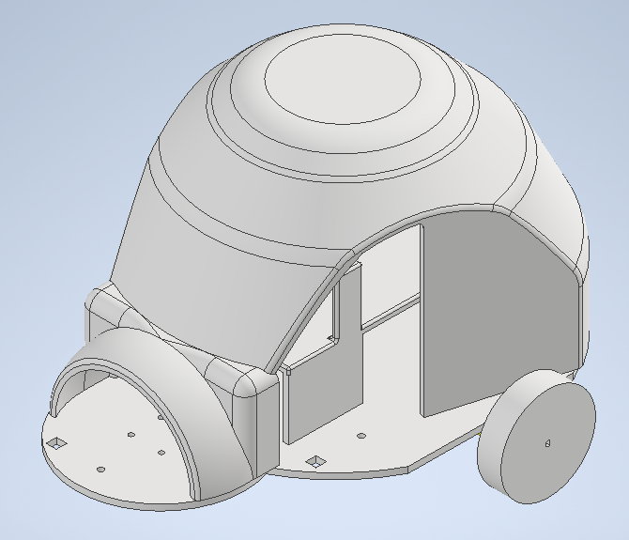
Design - Cover
Ladybug themed outer case, originally printed in black - spray painted red and small dots drawn on
Magnetic holes on edges to stick neatly onto base
Holes on sides and front to allow space for sensors
Also doubles as protection for electronic parts
Makes the Ladybug bot actually a ladybug!

Slide 6
I Obstacle Detection & Avoidance I
I Coding, Coordinates, Obstacles I

Slide 7
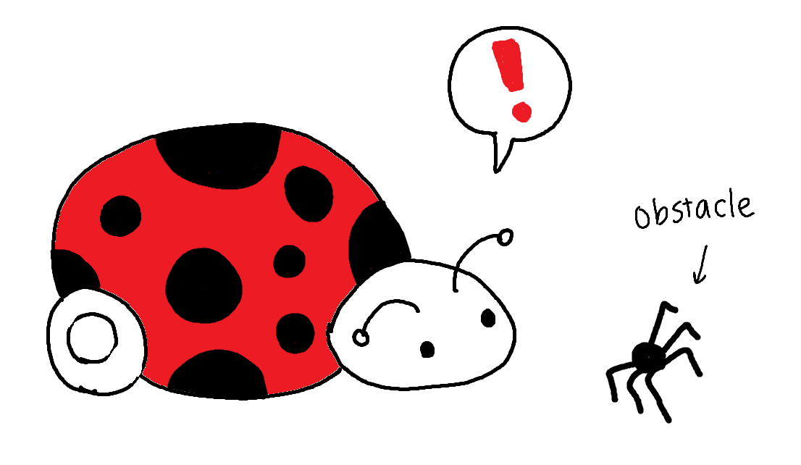
Obstacle Detection - Sensors & Coordinates
The Ladybug can sense obstacles around it using its ultrasonic sensors
When the sensors detect something within <10 cm range:
Obstacle detected!
Sensor readings are stored in a struct
All sensors can be read at once and don’t need to be called individually!
Once the obstacle is detected, the Ladybug can “map” it
Coordinates of the obstacle are determined accordingly based on:
Distance to the obstacle, gathered from the sensors
Current location of the Ladybug

Slide 8
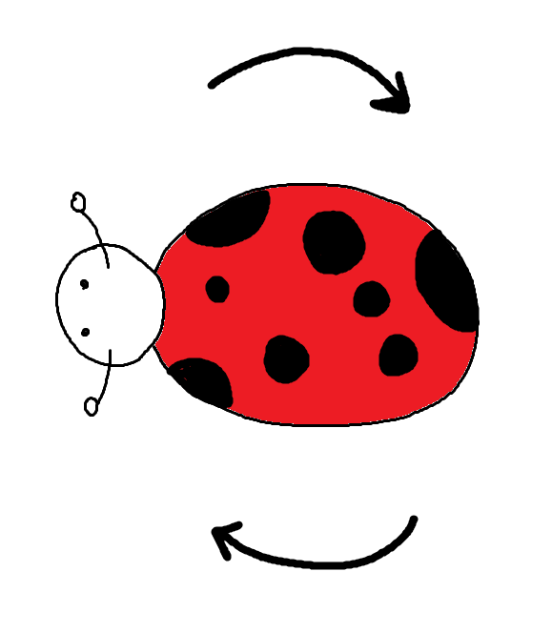
Obstacle Detection - Movement
The Ladybug can be programmed to avoid obstacles once detected!
Forward/backward movement commands can be issued with two inputs:
Speed (in cm per second)
Target distance (in cm)
The Ladybug will move at the input speed until the target distance is reached.
Turn commands can be issued with two inputs:
Speed (in cm per second)
Target angle displacement (in degrees)
All movements are set to a default speed of 8 cm/s
Default turns are 90 degrees

Slide 9
I Maze Solutions I
I Shortest Path and Dijkstra’s Algorithm I

Slide 10

Maze Solutions - Occupancy Grids
The Ladybug creates an occupancy grid of the map that gets updated with obstacles as it moves.
Each “cell” in the grid is 17cm x 17cm, and this creates a coordinate system.
The occupancy grid is printed with (in testing):
Start (S)
Goal (G)
Path cells (*)
Obstacle (#)
Regular cells (.)
But for simplicity is printed with 1s and 2s.

Slide 11
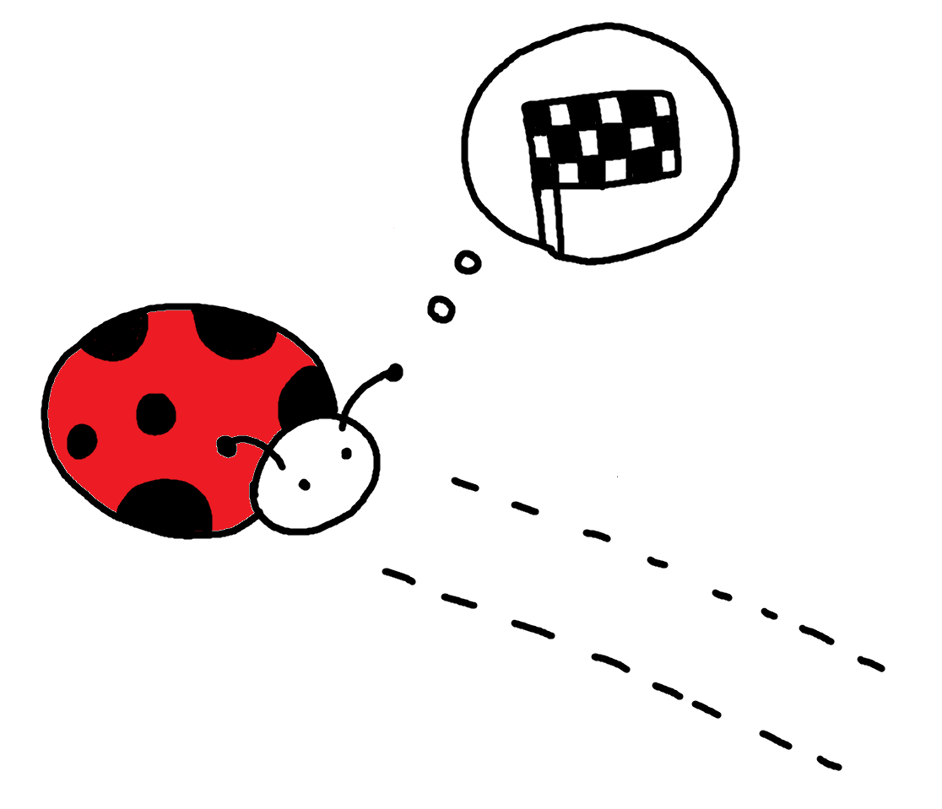
Maze Solutions - Dijkstra’s Algorithm
The Ladybug uses Dijkstra’s algorithm to compute the shortest path to the goal from the current point.
As obstacles are mapped out, the new path is computed considering the obstacles.
At the end, the Ladybug receives the shortest path to the goal as an array of coordinates.
It also receives the length of the shortest path (in steps).
In testing, the dijkstra() function can:
Print out a small map with the shortest path marked;
Print out the route as steps of coordinates.
Once the ladybug receives the path:
It will attempt to follow each coordinate step by step.
Once the new coordinate is reached:
Obstacles are sensed and added onto the map.
Dijkstra runs again and returns a new path
Process repeats until goal is reached!

Slide 12
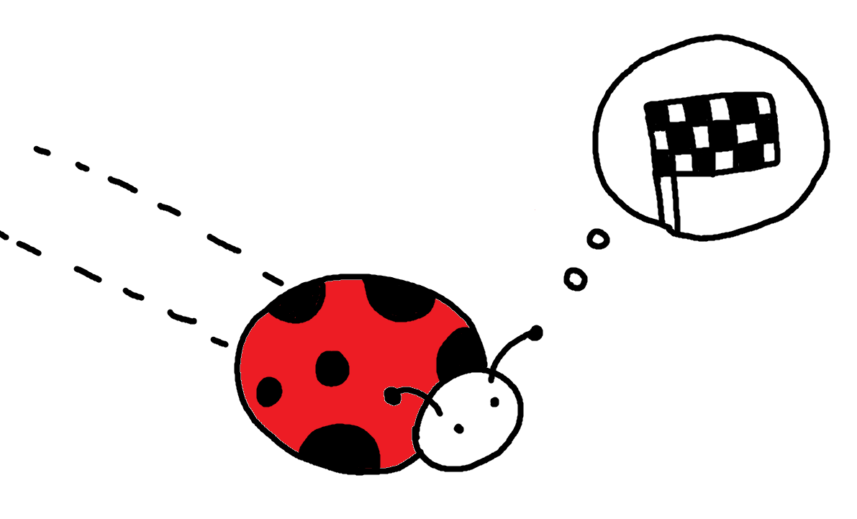
Maze Solutions - Backtracking
Once the goal is met, the Ladybug will reset its goal back to (0,0) - the start
It will rerun the algorithms until it reaches its new goal - the start!
The maze is then solved via Dijkstra’s!

Slide 13
I Bugsquashing I
I Problem Troubleshooting I

Slide 14
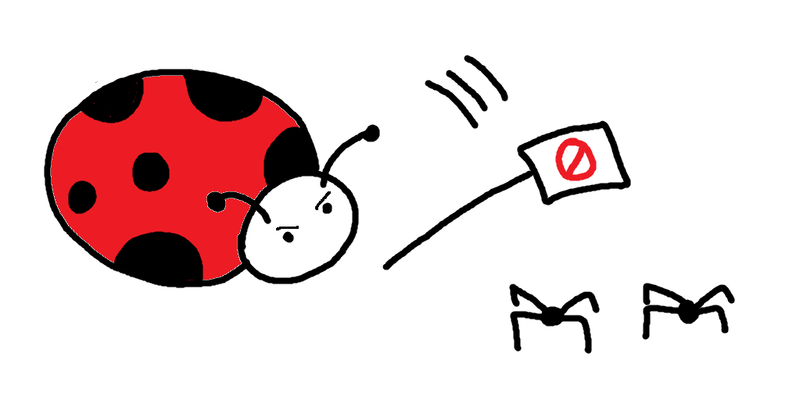
Bug-squashing
Bugs were fixed via repeated trial and error, and lots of print() statements!
Threading was used to optimise angle & distance calculations
They depended on the encoders
Running them in tandem with everything else increased efficiency
On initial submission, the Ladybug was able to find a path and update the map with obstacles, but struggled to follow the path properly.
This was (hopefully) fixed for the final presentation to ensure a smooth demonstration

Slide 15
I Improvements & Evaluation I
I What could’ve gone better? I

Slide 16
I Thank you! I
I Any Questions? I

